Slide 1
Project 9: EKF-based Localisation with LRF
Presentation 5:
Results
Notes:
Hello, this is our final presentation on project number 9: EKF-based localisation with a LRF

Slide 2
Outline
Results
AA
BB
CC
To Do List
Questions
Notes:
In comparison to the last weeks we have a lot of progress and results to show, that‘s why I wont explain the outline of this presentation. Let’s just dive into the results and see what we were able to do.

Slide 3
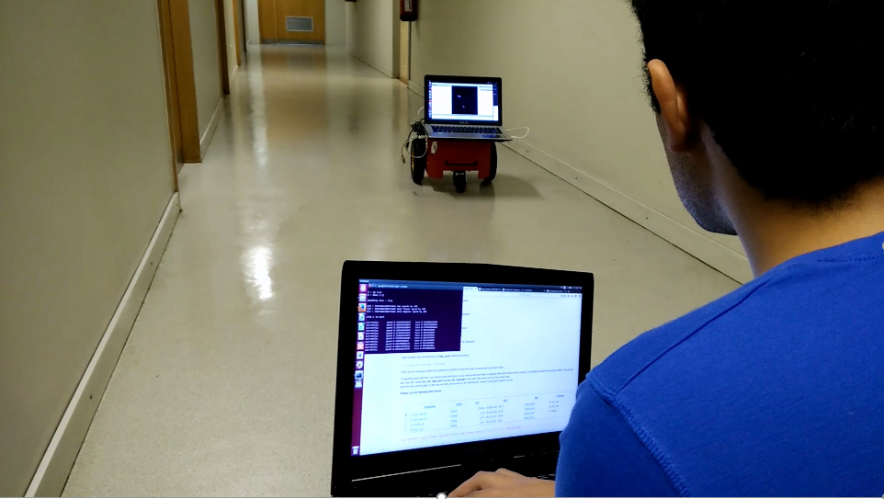
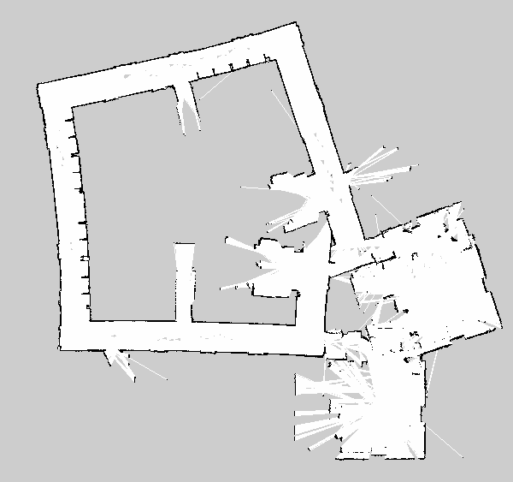
Results (1)
3 weeks ago:
ROSARIA, Odometry, LRF and RVIZ
Mapping with gmapping
Remote controlling
Next step: Coding EKF
LRF
Matching
Improve!
Prediction
Update
Odometry
Observation model
Map
Notes:
Yet to be written

Slide 4

Results (2)
Today:
Preparation for implementation of EKF
Gazebo with world map, Pioneer 3DX and LRF
Publisher and subscriber python code
Improved map
Faced a lot of problems with gazebo & the mapping
Not as much progress as planned
Everything is prepared for implementing EKF
Notes:
Yet to be written

Slide 5
To Do List
Finish the report until Sunday night
Work towards poster presentation
Improve measurements and create more data
Notes:
Yet to be written

Slide 6
Questions
???
Notes:
Yet to be written

